Slide 1
Chapter 8 Objects and Classes

Slide 2
OO Programming Concepts
Object-oriented programming (OOP) involves programming using objects. An object represents an entity in the real world that can be distinctly identified. For example, a student, a desk, a circle, a button, and even a loan can all be viewed as objects. An object has a unique identity, state, and behaviors. The state of an object consists of a set of data fields (also known as properties) with their current values. The behavior of an object is defined by a set of methods.

Slide 3
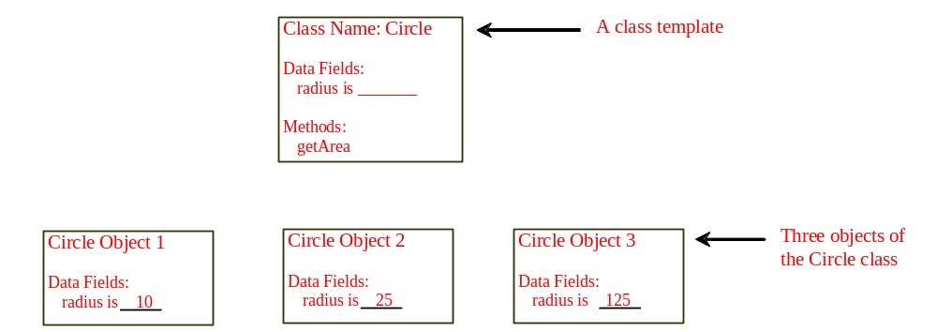
Objects
An object has both a state and behavior. The state defines the object, and the behavior defines what the object does.

Slide 4
Classes
Classes are constructs that define objects of the same type. A Java class uses variables to define data fields and methods to define behaviors. Additionally, a class provides a special type of methods, known as constructors, which are invoked to construct objects from the class.

Slide 5
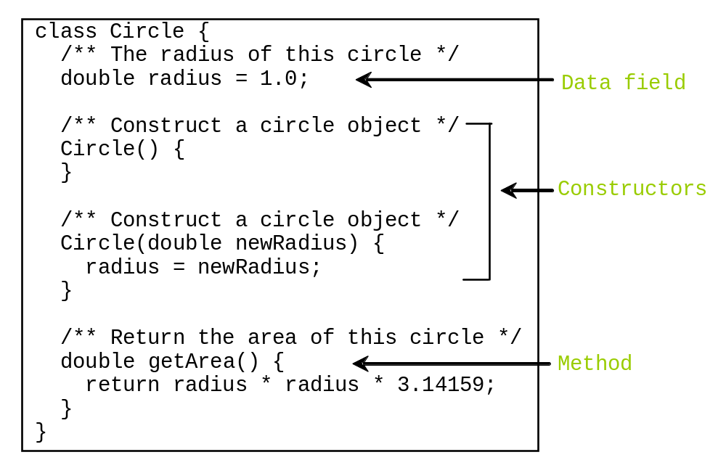
Classes

Slide 6
Example: Defining Classes and Creating Objects
Objective: Demonstrate creating objects, accessing data, and using methods.
TestSimpleCircle
Run

Slide 7
Constructors
Constructors are a special kind of methods that are invoked to construct objects.
Circle() {
}
Circle(double newRadius) {
radius = newRadius;
}

Slide 8
Constructors, cont.
A constructor with no parameters is referred to as a no-arg constructor.
· Constructors must have the same name as the class itself.
· Constructors do not have a return type—not even void.
· Constructors are invoked using the new operator when an object is created. Constructors play the role of initializing objects.

Slide 9
Creating Objects Using Constructors
new ClassName();
Example:
new Circle();
new Circle(5.0);

Slide 10
Default Constructor
A class may be defined without constructors. In this case, a no-arg constructor with an empty body is implicitly declared in the class. This constructor, called a default constructor, is provided automatically only if no constructors are explicitly defined in the class.

Slide 11
Declaring Object Reference Variables
To reference an object, assign the object to a reference variable.
To declare a reference variable, use the syntax:
ClassName objectRefVar;
Example:
Circle myCircle;

Slide 12
Declaring/Creating Objects in a Single Step
ClassName objectRefVar = new ClassName();
Example:
Circle myCircle = new Circle();
Assign object reference
Create an object

Slide 13
Accessing Object’s Members
Referencing the object’s data:
objectRefVar.data
e.g., myCircle.radius
Invoking the object’s method:
objectRefVar.methodName(arguments)
e.g., myCircle.getArea()

Slide 14
Trace Code
animation
Declare myCircle
Circle myCircle = new Circle(5.0);
SCircle yourCircle = new Circle();
yourCircle.radius = 100;
myCircle
no value

Slide 15
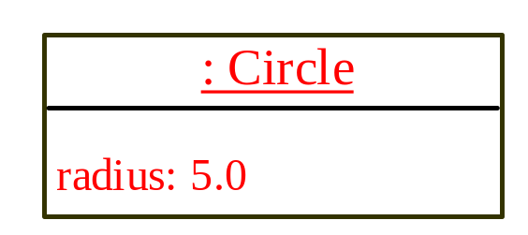
Trace Code, cont.
animation
Circle myCircle = new Circle(5.0);
Circle yourCircle = new Circle();
yourCircle.radius = 100;
myCircle
no value
Create a circle

Slide 16
Trace Code, cont.
animation
Circle myCircle = new Circle(5.0);
Circle yourCircle = new Circle();
yourCircle.radius = 100;
myCircle
reference value
Assign object reference to myCircle

Slide 17
Trace Code, cont.
animation
Circle myCircle = new Circle(5.0);
Circle yourCircle = new Circle();
yourCircle.radius = 100;
myCircle
reference value
yourCircle
no value
Declare yourCircle

Slide 18
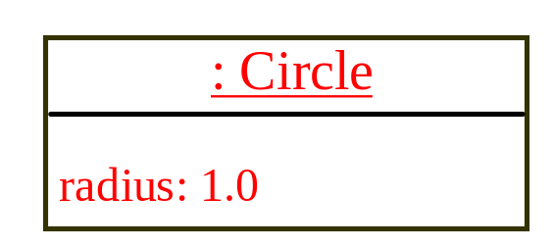
Trace Code, cont.
animation
Circle myCircle = new Circle(5.0);
Circle yourCircle = new Circle();
yourCircle.radius = 100;
myCircle
reference value
yourCircle
no value
Create a new Circle object

Slide 19
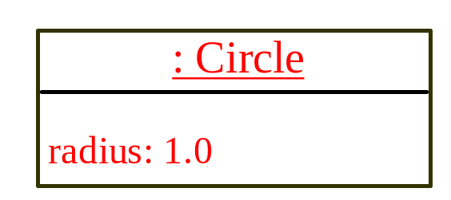
Trace Code, cont.
animation
Circle myCircle = new Circle(5.0);
Circle yourCircle = new Circle();
yourCircle.radius = 100;
myCircle
reference value
yourCircle
reference value
Assign object reference to yourCircle

Slide 20
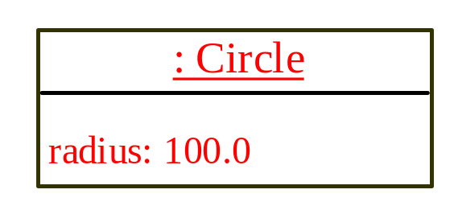
Trace Code, cont.
animation
Circle myCircle = new Circle(5.0);
Circle yourCircle = new Circle();
yourCircle.radius = 100;
myCircle
reference value
yourCircle
reference value
Change radius in yourCircle

Slide 21
The null Value
If a data field of a reference type does not reference any object, the data field holds a special literal value, null.

Slide 22
Default Value for a Data Field
The default value of a data field is null for a reference type, 0 for a numeric type, false for a boolean type, and '\u0000' for a char type. However, Java assigns no default value to a local variable inside a method.
public class Test {
public static void main(String[] args) {
Student student = new Student();
System.out.println("name? " + student.name);
System.out.println("age? " + student.age);
System.out.println("isScienceMajor? " + student.isScienceMajor);
System.out.println("gender? " + student.gender);
}
}

Slide 23
Example
Java assigns no default value to a local variable inside a method.
public class Test {
public static void main(String[] args) {
int x; // x has no default value
String y; // y has no default value
System.out.println("x is " + x);
System.out.println("y is " + y);
}
}
Compilation error: variables not initialized

Slide 24
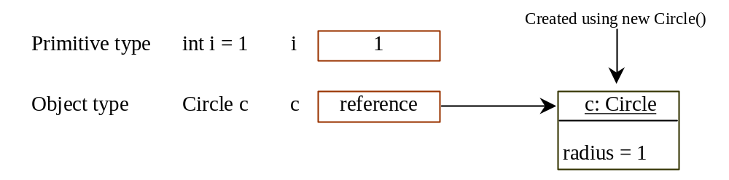
Differences between Variables of
Primitive Data Types and Object Types

Slide 25
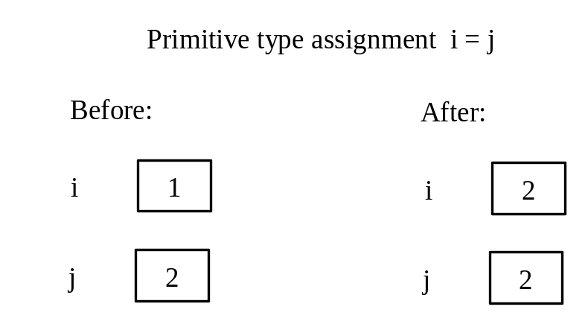
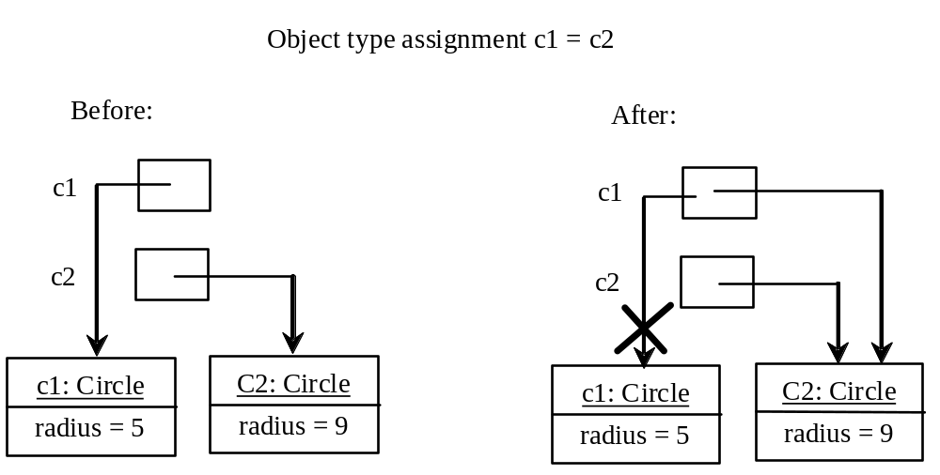
Copying Variables of Primitive Data Types and Object Types

Slide 26
Garbage Collection
As shown in the previous figure, after the assignment statement c1 = c2, c1 points to the same object referenced by c2. The object previously referenced by c1 is no longer referenced. This object is known as garbage. Garbage is automatically collected by JVM.

Slide 27
Garbage Collection, cont
TIP: If you know that an object is no longer needed, you can explicitly assign null to a reference variable for the object. The JVM will automatically collect the space if the object is not referenced by any variable.

Slide 28
Instance
Variables, and Methods
Instance variables belong to a specific instance.
Instance methods are invoked by an instance of the class.

Slide 29
Static Variables, Constants, and Methods
Static variables are shared by all the instances of the class.
Static methods are not tied to a specific object.
Static constants are final variables shared by all the instances of the class.

Slide 30
Static Variables, Constants, and Methods, cont.
To declare static variables, constants, and methods, use the static modifier.

Slide 31
Visibility Modifiers and
Accessor/Mutator Methods
By default, the class, variable, or method can be
accessed by any class in the same package.
public
The class, data, or method is visible to any class in any package.
private
The data or methods can be accessed only by the declaring class.
The get and set methods are used to read and modify private properties.

Slide 32
Why Data Fields Should Be private?
To protect data.
To make class easy to maintain.

